Slide 1
Connecting eastern monarch population dynamics across their migratory cycle
Leslie Ries, Univ. of MD
Karen Oberhauser, Univ. of MN
Elise Zipkin, USGS (Patuxent)
Doug Taron, IL BMS
Eduardo Rendon, WWF-Mexico

Slide 2
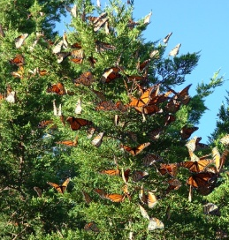
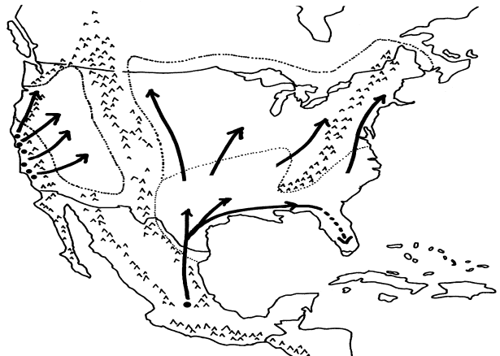

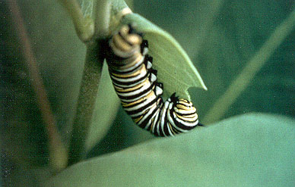
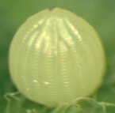
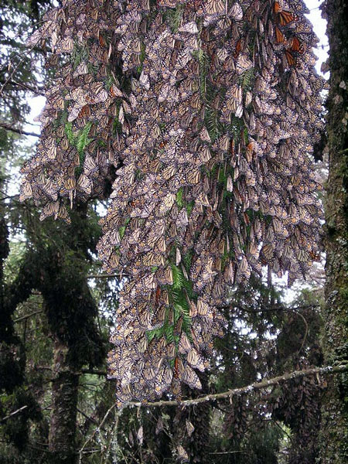
Monarchs have a complex migratory cycle that makes tracking population dynamics challenging
Stage 3: Summer expansion and breeding
Dynamics in one stage have carry-over effects into subsequent stages
On the other hand, it is largely one population, rather than a series of loosely connected “sub” populations
Stage 4:
Fall migration
Stage 2:
Spring migration and breeding
Stage 1:
Overwintering

Slide 3
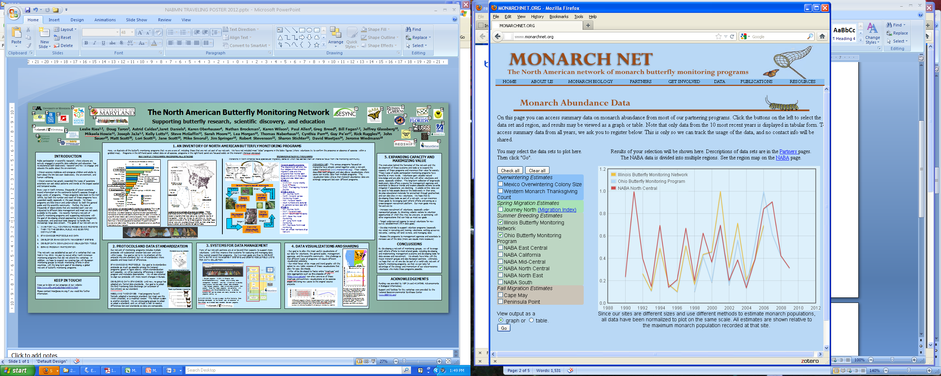
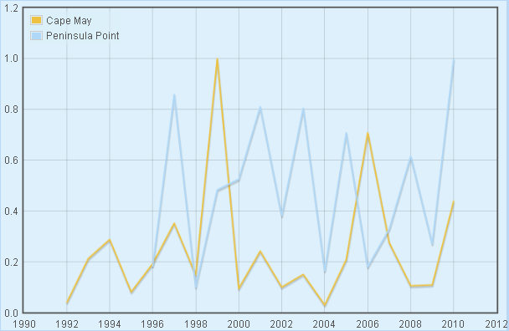
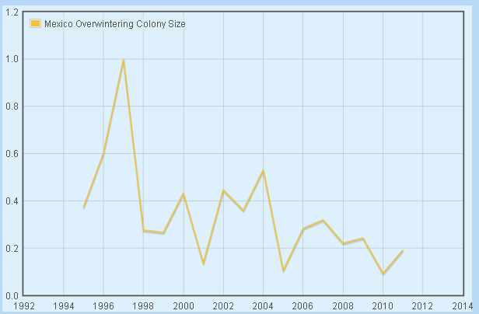
Understanding monarch population dynamics is critical for their conservation
Notable patterns:
  Eastern monarchs may be declining, but examining different life stages suggests different patterns
  Monarch populations show large fluctuations from year to year
Underlying mechanisms
  REGIONAL CONNECTIONS: How do dynamics in one phase of the migratory cycle influence dynamics in subsequent phases?
  ENVIRONMENTAL INFLUENCE: How much do environmental factors influence the connection between these phases?
SUMMER MONITORING DATA
FALL MONITORING DATA
WINTER MONITORING DATA

Slide 4
How can we track dynamics through each life stage?
Monarch Health
started ‘99
N. American Bfly Assoc.
started 1975
Ohio BMS
started ’96
Gen 3/4 adults
Gen 3/4 eggs
Illinois BMS
started ’87
Florida BMS
started ’03
Gen 2 adults
Monarch Larvae Monitoring Project
started ‘99
Gen 2 eggs
Expansion
Gen 1 adults
Cape May Roosts
started ‘92
Gen 1 eggs
Migrants going south
Journey South
started ’99
Monarch Watch
started ’92
Peninsula Point Roosts
started ‘96
Journey North
started ‘99
Migrants going north
Adults arriving in Mexico
WWF-Mexico
started ’96
started tracking overwinter mortality in 2003
Surviving overwinter adults

Slide 5
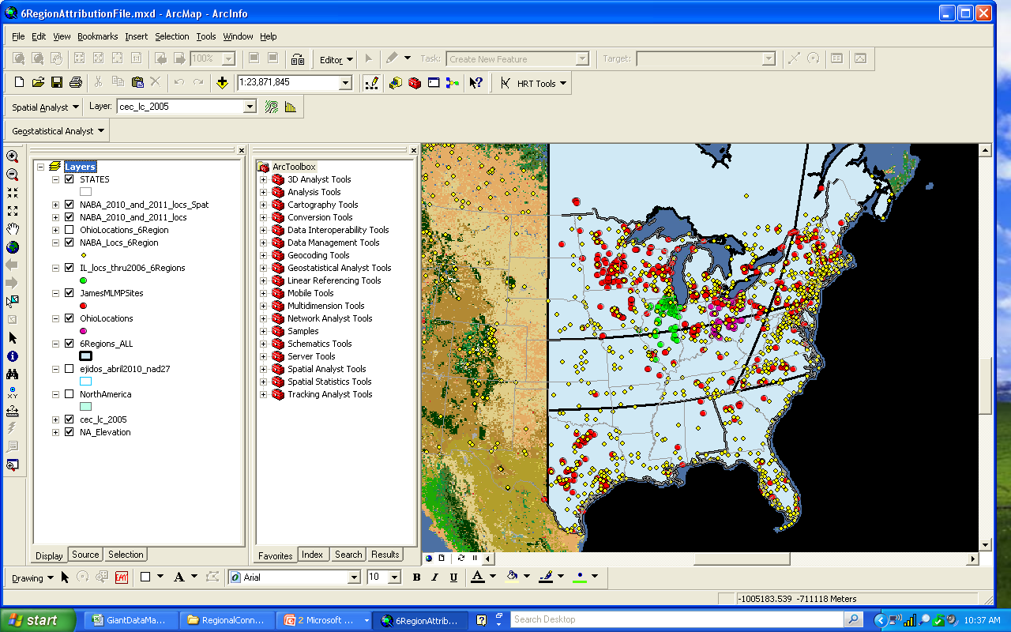
Data Available for Analysis
Monarch Larvae Monitoring Project (MLMP)
North American Butterfly Association Counts (NABA)
Ohio Butterfly Monitoring Scheme (OH)
Illinois Butterfly Monitoring Scheme (IL)
Cape May (CM)
WWF-Mexico (MEX)
(’95 winter start; ‘04 winter end)
Mexican sites

Slide 6
Data Available for Analysis
N-East
Monarch Larvae Monitoring Project (MLMP)
North American Butterfly Association Counts (NABA)
N-Central
Ohio Butterfly Monitoring Scheme (OH)
South
Cape May (CM)
WWF-Mexico (MEX)
(’95 winter start; ‘04 winter end)
Mexican sites

Slide 7
Tracking the population through each region and stage
Do the number of adults surviving the winter in Mexico relate to the number of adults arriving in the Texas area in spring?
Do the number of spring arriving adults relate to the number of 1st gen eggs that are recorded?
Mexican sites

Slide 8
Tracking the population through each region and stage
Do the number of adults surviving the winter in Mexico relate to the number of adults arriving in the Texas area in spring?
Do the number of spring arriving adults relate to the number of 1st gen eggs that are recorded?
How do the number of spring adults or eggs relate to the number of 1st generation arrivals in the northern regions?
Mexican sites

Slide 9
Tracking the population through each region and stage
Do the number of adults surviving the winter in Mexico relate to the number of adults arriving in the Texas area in spring?
Do the number of spring arriving adults relate to the number of 1st gen eggs that are recorded?
How do the number of spring adults or eggs relate to the number of 1st generation arrivals in the northern regions?
Can the number of 1st generation adults / 2nd generation eggs predict numbers in subsequent generations?
Mexican sites

Slide 10
Tracking the population through each region and stage
Do the number of adults surviving the winter in Mexico relate to the number of adults arriving in the Texas area in spring?
Do the number of spring arriving adults relate to the number of 1st gen eggs that are recorded?
How do the number of spring adults or eggs relate to the number of 1st generation arrivals in the northern regions?
Can the number of 1st generation adults / 2nd generation eggs predict numbers in subsequent generations?
Can the size of the population at the last stages of the breeding cycle predict the number of fall migrants?
Mexican sites

Slide 11
Tracking the population through each region and stage
Do the number of adults surviving the winter in Mexico relate to the number of adults arriving in the Texas area in spring?
Do the number of spring arriving adults relate to the number of 1st gen eggs that are recorded?
How do the number of spring adults or eggs relate to the number of 1st generation arrivals in the northern regions?
Can the number of 1st generation adults / 2nd generation eggs predict numbers in subsequent generations?
Can the size of the population at the last stages of the breeding cycle predict the number of fall migrants?
Can the size of the population at the last stages of the breeding cycle predict the number of Mexican arrivals?
Mexican sites

Slide 12
Q1 and Q2. How do overwintering numbers relate to the number of arriving adults and how do arriving adults influence the number of eggs we see in the spring?
Mexican migrants and spring adults
Spring adults and spring eggs
r=0.5 p=0.25
r=0.34 p=0.51
A non-existent (or weak) relationship between the number of adults leaving Mexico and the number arriving in Texas and surrounding areas in the spring. And no hint of a relationship between spring adults and eggs. But there are few data available to rigorously make these comparisons!!

Slide 13
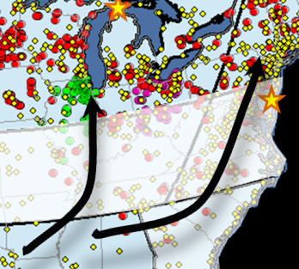
Q3. How do the number of spring adults or eggs relate to the number of 1st generation arrivals in the northern regions?
NOTE: There are eight combinations of comparisons here, none show significant relationships (the strongest patterns are shown below).
1st gen eggs in south to 2nd gen eggs North
Migrant adults in south to 1st gen adult arrivals
r=0.5 p=0.13
r=0.69 p=0.12
A weak, or non-existent, relationship between the spring generation and summer arrivals in the north could be due to lack of data, or swamping out by environmental factors.

Slide 14
Q3. Can the number of 1st generation adults / 2nd generation eggs predict numbers in subsequent generations?
N-East:
r=0.899 p=<0.0001
r=0.85 p=0.004
N-Central:
r=0.7925 p=<0.0001
r=0.73 p=0.005
YES: This suggests that the number of arrivals in the northern breeding grounds from the southern spring generation has a strong influence on the ultimate size of that year’s population.

Slide 15

Tracking climate’s impacts on the migratory monarch butterfly
Approximate limit of breeding
a)
center of
summer
recruitment
b)
We examined the impacts on population growth in Ohio of:
Spring temperature (in Texas)
Spring precipitation (in Texas)
Summer temperature (in Ohio)
Summer precipitation (in Ohio)
Years of data
1-4
5-9
10-13
Overwintering site

Slide 16
Patterns based on simple climate metrics aren’t informative
a)
b)
Mean number monarchs/hr (weeks 26-28)
Summer peak population size (Ohio)
Spring temperature (GDD in Texas)
Summer temperature (GDD in Ohio)
c)
d)
Spring precipitation (Texas)
Summer drought index (Ohio)

Slide 17
Meaningful patterns emerge when patterns are evaluated in a multiple regression framework, taking site characteristics into account
a)
Standardized spring Precip in TX
Coolest sites
Spring precipitation (cm) in TX (standardized)
Summer GDD in OH (standardized)
Standardized summer GDD in Ohio
b)
Avg site
Standardized spring GDD in TX
Spring GDD in TX (standardized)
Week
Warmest sites
Zipkin et al. (in press): Global Change Biology
Week

Slide 18
The story so far…
No relationship between adults leaving Mexico, arriving in the South, and laying eggs
Weak (or non-existent) relationship between adults arriving in the South, next generation arrivals in the North and egg-laying
  The disconnect may be due to the importance of spring climate on the ultimate population size (and/or health) of migrants to the North
A strong relationship between the numbers arriving in the North and laying eggs and the size of the population at the end of the summer.
  This suggests that the size of that first generation produced in the spring that arrives in the North is an important contributor to yearly population sizes and (again) that spring climate is important
Next up: Population connections on the return trip

Slide 19
Q5. Can the size of the population at the last stages of the breeding cycle predict the number of fall migrants?
r=0.61 p=0.005

Slide 20
Q6. Can the size of the population at the last stages of the breeding cycle predict the number of Mexican arrivals?
r=0.00 p=0.99
r=-0.01 p=0.69
NO? This lack of relationship is surprising given results of past (admittedly smaller) analyses, and deserves further examination.

Slide 21
Conclusions and future directions
Growth during the summer breeding season is the most important factor driving yearly population sizes
  The number (or health) of migrants arriving from the southern US into the north is a key driver of population growth and this may be driven by climate
  Summer climate also influences summer growth
There seems to be little congruence between winter colony size and the spring and summer detection rates from butterfly surveys
  Loss of milkweed (not captured by surveys) may be influencing winter, but not summer, values (Pleasants and Oberhauser, in press)
We will continue to develop this “regional connections” framework
  Include data from other programs
  Repeat analyses as data resources grow
  Continue to develop mechanistic models that explore environmental impacts on specific stages or linkages

Slide 22


Acknowledgements
All members of MonarchNet
NCEAS monarch working group
Program coordinators and the thousands of volunteers!!!
Funding:
Monarch Joint Venture
CEC
SESYNC

Slide 23
Results: Winter counts are related to the previous summer (but not vice-versa)
Gen 2-4 adults
Gen 2-4 adults
Overwintering adults
Overwintering adults
Illinois: r = 0.72, p = 0.005
Ohio: r = 0.80, p = 0.009
4July: r = 0.38, p = 0.21*
Illinois: r = 0.13, p = 0.68
Ohio: r = 0.08, p = 0.83
4July: r = 0.17, p = 0.60
*Data can be expanded to their full range and for the full 30 years of winter data

Slide 24
Two main questions
REGIONAL CONNECTIONS ANALYSIS: How do dynamics in one phase of the migratory cycle influence dynamics in subsequent phases?
CLIMATE ANALYSIS: How much do environmental factors influence the connection between these phases?
Stage 3: Summer expansion and breeding
Stage 4:
Fall migration
Stage 2:
Spring migration and breeding
Stage 1:
Overwintering

Slide 25
Monarch Net:
A network of monarch monitoring groups
For more information, see monarchnet.org and the Butterfly Monitoring Poster

Slide 26
How can we track dynamics through each life stage?
N. American Bfly Assoc.
started 1975
Gen 3/4 adults
Gen 3/4 eggs
Gen 2 adults
Monarch Larvae Monitoring Project
started ‘99
Gen 2 eggs
Expansion
Cape May Roosts
started ‘92
Gen 1 adults
Gen 1 eggs
Migrants going south
Migrants going north
Adults arriving in Mexico
WWF-Mexico
started ’96
started tracking overwinter mortality in 2005
Surviving overwinter adults

