Slide 1
Butterflies as a model system to understand the interaction of landscape and climate
Leslie Ries
National Socio-environmental Synthesis Center (SESYNC), Annapolis, MD
Department of Biology
University of Maryland, College Park
Nick Haddad
Department of Biology
North Carolina State University (NCSU), Raleigh

Slide 2
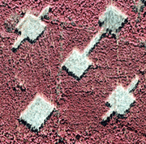
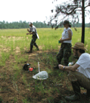
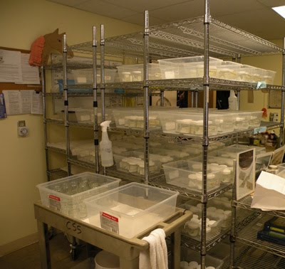
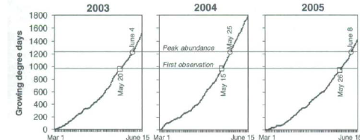

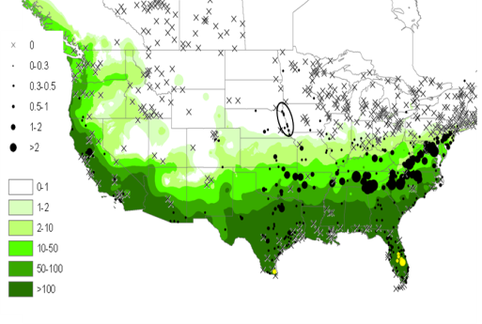
Leslie Ries – SESYNC
Large-scale butterfly monitoring by citizen-scientists
Nick Haddad - NCSU
Laboratory and field research on fragmentation responses and physiological constraints
Informatics:
-Data access
- Data visualization
- Analytical models
Research program:
-Leveraging lab and field studies to carry out the most rigorous large-scale analyses
Field experiments:
-Fragmentation and corridors
- Restoration for rare butterflies
Research program:
-Understanding global change through the interaction of landscape and climate
Observations per party-hour
2006
x
>10
5-10
1-5
<1
0
.
Key findings:
-Butterflies have intermediate optimal temperatures
- Lethal and sub-lethal temperatures may be rare now, but are likely to become increasingly common
Key findings:
- Responses to landscape structure can be predicted by small-scale processes
- Seasonal temperatures can be the best predictor of butterfly phenology

Slide 3
Key niches, opportunities and research questions
Leslie Ries – SESYNC
Nick Haddad – NCSU
Focus on the rarest butterflies, many of which are likely impacted by climate change
Integrate the dual effects of climate change and habitat fragmentation
Incorporating projections for the best-known insects into SERAP models
Working with a number of NCSU faculty, including Dunn, Gilliam, Franks, and others
Long-term staffing to support data-intensive synthesis research
Current 4-year funding specifically to develop butterfly informatics resources for synthesis research
Opportunities to collaborate with incoming SESYNC researchers
Large-scale analyses of current butterfly distributions based on mechanistic models built from small-scale field and laboratory results
The goal is to use this approach to confirm current understanding of physiological constraints or expose gaps in our knowledge
Identify climate extremes that are likely to have the strongest impacts across the largest number of species
Understand the interaction of landscape and climate

Slide 4
Key science partners
Academic collaborators
Karen Oberhauser, Univ of MN (monarch responses to climate change)
Earth System Science Interdisciplinary Center, University of Maryland (potential collaborator)
Federal Partners
Department of Defense (controls much of the conservation land in the southeastern coastal plain)
USGS Southeast Regional Assessment Project (role?)
US Forest Service (facilitates landscape-scale habitat manipulations)
US Fish and Wildlife Service (interest in the protection of the rarest butterflies)
Non-governmental Organizations
Defenders of Wildlife (recently initiated a program on butterflies and climate and is currently working with Ries to develop research priorities)
There are many NGOs that will approach about becoming collaborators, including the Wildlands Netork, The Nature Conservancy, and World Wildlife Fund
Museums
The McGuire Center at the Florida Museum of Natural History (currently working with Haddad on preservation of the Miami blue)

Slide 5
Continuing efforts towards a research program dedicated to understanding global change
One of our most important long-term goals is to make climate change’s impacts on insects more predictable. We will do this by determining the extent to which physiological constraints measured in the lab or field can be used to reliably predict current and future ranges and seasonal timing
Integrating knowledge of butterfly responses to climate with knowledge of how fragmentation affects range shifts and extinction dynamics will allow a more powerful consideration of each of the two dominant stressors on biodiversity
The use of the results of these and similar studies will help develop robust conservation networks that preserve biodiversity in the face of climate change.
SESYNC is dedicated to supporting large-scale synthetic research and, as an NSF-funded synthesis center, can expect 10 years of NSF funding (contingent on satisfactory progress after a 5-year review) and also plans to develop a strong external funding program that will allow it to continue past the 10 year window
SESYNC research topics are community-driven, but climate and land-use change have consistently been identified as primary research priorities within socio-environmental research, and so it is certain to be a integral part of the research program there.
Ries will continue to seek funding to strengthen the networks, relationships and infrastructure supporting the expansion and use of citizen-science monitoring programs in conservation and climate research

